Slide 1
College code -7125
Name: N.KANMANI
Register number: 712521121005
Data warehousing with IBM cloud Db2 warehouse

Slide 2
Objectives:
The objective of the project are outlined below:
1. Data warehousing encompasses a broad range of
Activities.
2. Specifically,it includes data extraction, transformation and loading.
3. Support decision making and problem solving.

Slide 3
Design thinking process:
1. Engineer requirements
2.discover data needs
3. Conceptualize data warehouse
4. Plan the project
5. Select data warehouse technologies
6. Model data and design ETL processes

Slide 4
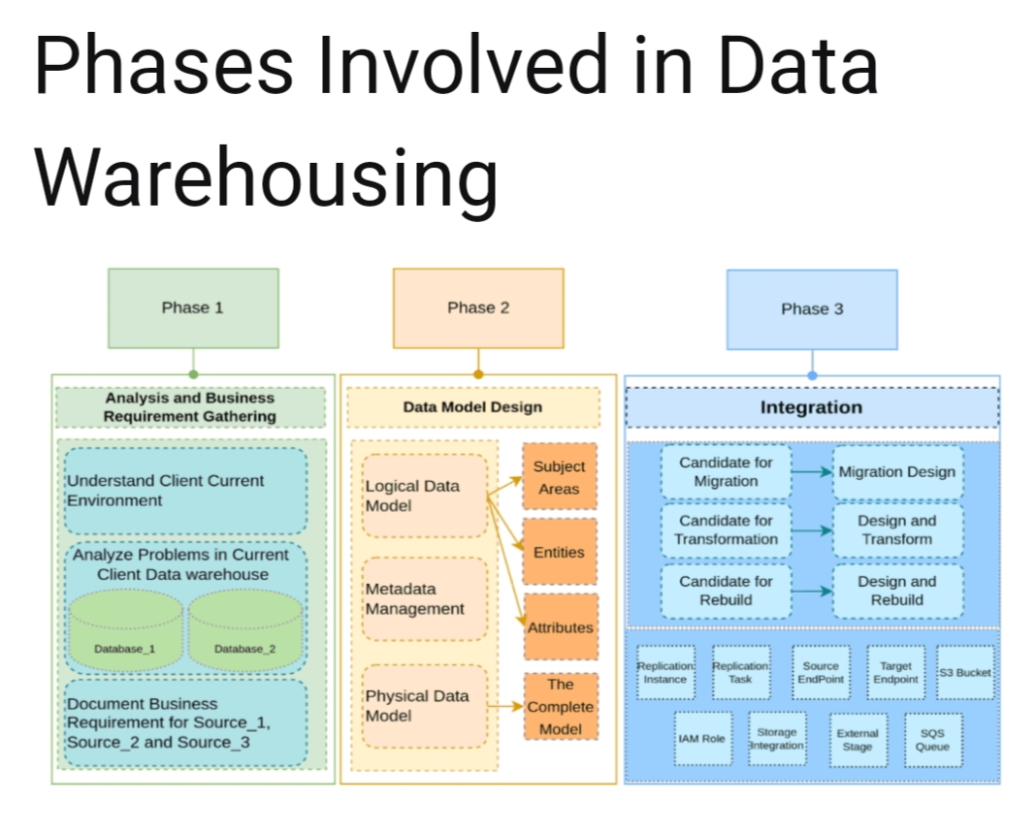

Slide 5
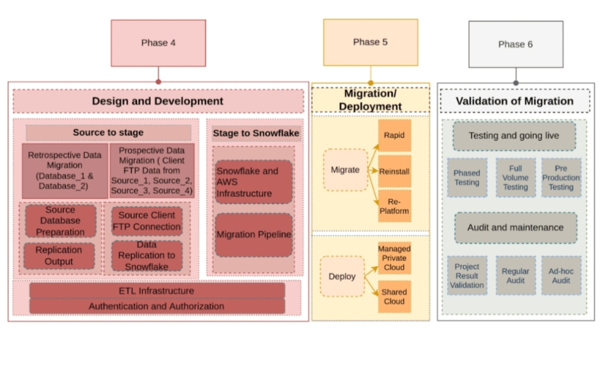

Slide 6
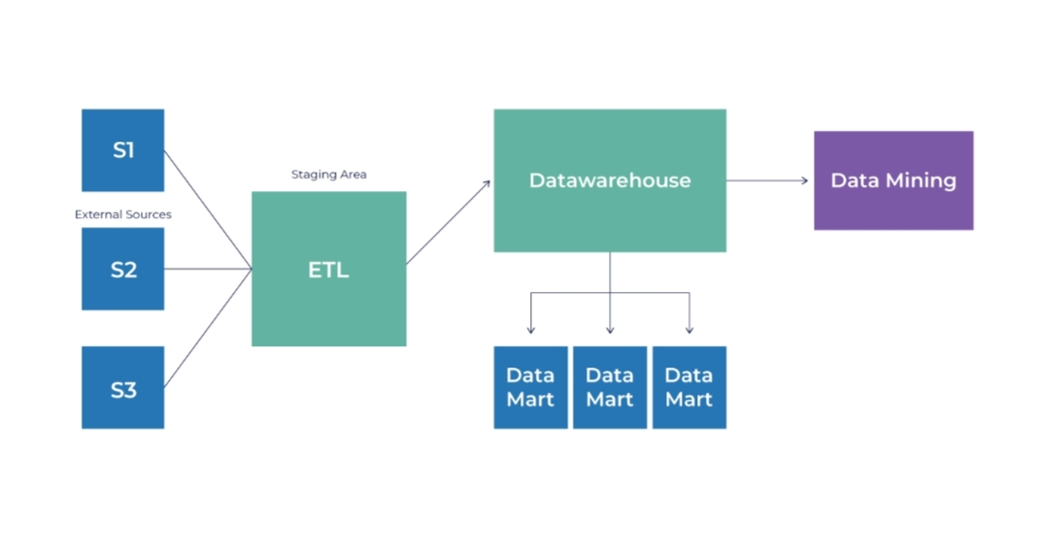
Data warehouse structure :

Slide 7
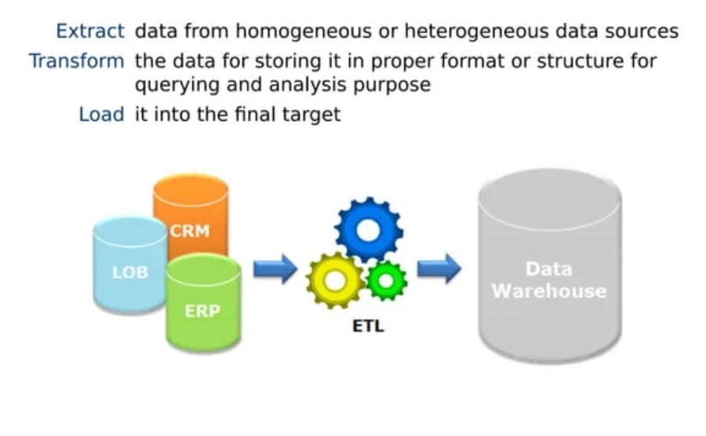
ETL processes:

